Slide 1
Introduction to Neural Networks with Keras
Adithya Viswanathan

Slide 2
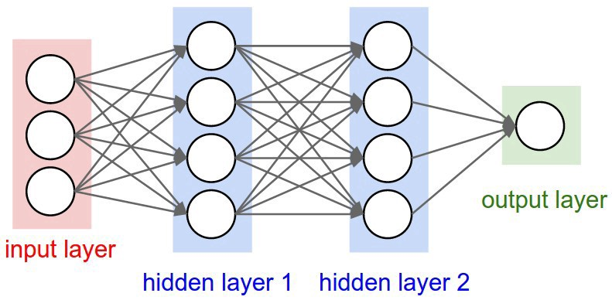
What is a Neural Network?
Node-based model
Connected nodes (like our brains)
Input nodes -> Hidden nodes -> Output nodes
Weights and Biases

Slide 3
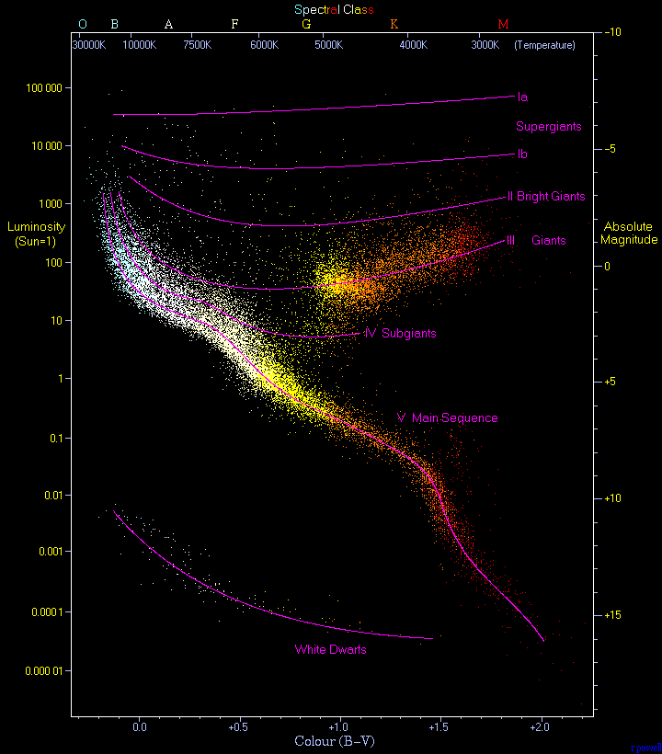
https://www.kaggle.com/deepu1109/star-dataset

Slide 4

Preprocessing the Data
Remove rows with null values
Remove unnecessary columns
Convert non-numerical data to numerical data
Standardize the data
z = Z-Score Standardization
x = Data points
μ = Mean (average)
σ = Standard Deviation

Slide 5
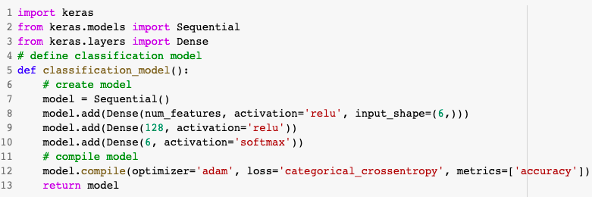
Model Preparation

Slide 6
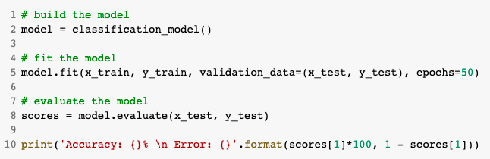
Training the model

Slide 7
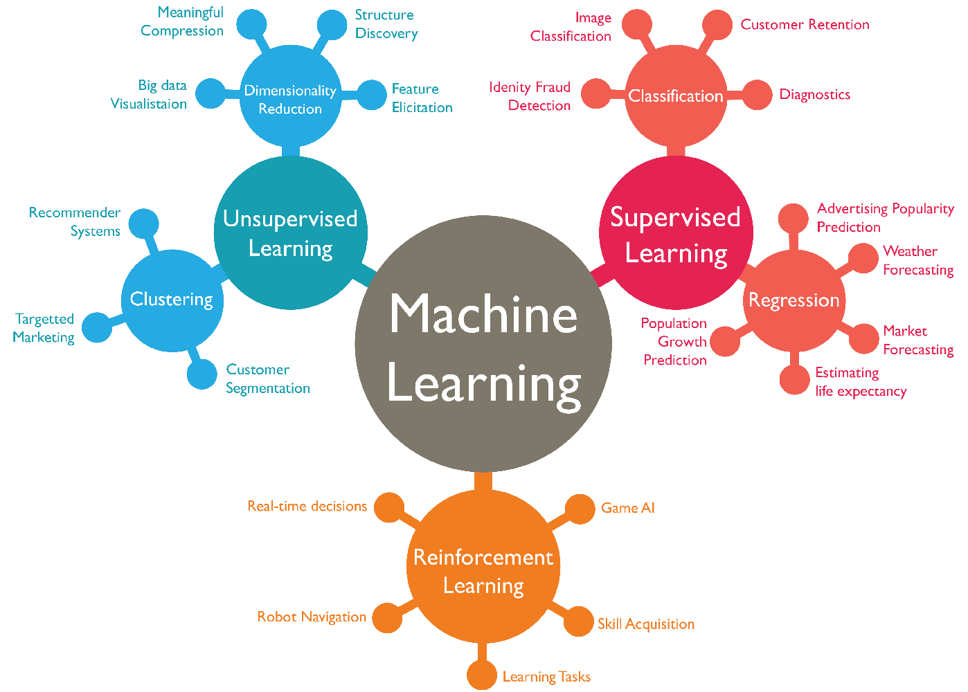

Slide 8
Good Resources
Datasets:https://www.kaggle.com
Preprocessing:https://www.analyticsvidhya.com/blog/2016/07/practical-guide-data-preprocessing-python-scikit-learn/
Neural_Nets:https://towardsdatascience.com/a-gentle-introduction-to-neural-networks-series-part-1-2b90b87795bc
https://medium.datadriveninvestor.com/the-basics-of-neural-networks-304364b712dc?gi=a73a5999f43c
Train/Test: https://data-flair.training/blogs/train-test-set-in-python-ml/

